Slide 1


Facilitator Guide to Student Preparation and Orientation for Placement
School of Health
Faculty of Medicine and Health
2023

Slide 2


Presentation title to go here
Acknowledgement of Country
The University of New England respects and acknowledges that its people, courses and facilities are built on land, and surrounded by a sense of belonging, both ancient and contemporary, of the world’s oldest living culture. In doing so, UNE values and respects Indigenous knowledge systems as a vital part of the knowledge capital of Australia.
We recognise the strength, resilience and capacity of the Aboriginal community and pay our respects to the Elders past, present and future.
Pictured: Warwick Keen “Always was, always will be” 2008
Gifted by the artist to UNE in 2008

Slide 3
Facilitator Guide to student placement
Clinical Staff within the School
Clinical Coordinator Academic: Anthea Fagan fcpnursing_academic@une.edu.au 67733657
WIL Coordinator: Jillian Fitzgerald fcpwil_coord@une.edu.au 67733640
WIL Liaison officer: Alisa Kennedy fcp_willo@une.edu.au 67734533
Clinical Officers: Kelly Winter, Ellie Monley, Michelle Wright and Sarita Perston nursingplacements@une.edu.au 6773 4388

Slide 4
Orientation Requirements
Introduction
The first day of any placement for a student and Clinical Partner/Facilitator is often the most stressful and often sets up the relationship between the student and facilitator. For all UNE facilitated placements it is expected that students will receive a orientation.
The following is an outline of minimum expectations and requirements for UNE students:
Adaptations that suit individual facilities Health Services are encouraged. Please amend and add to the manual site specific information in the relevant sections.
Please remember that UNE are here to help
Notes:
This is a guidance slide ONLY please commence the presentation to students from slide no 7

Slide 5
Pre Placement Preparation
There are a number of considerations that you should be thinking about prior to the commencement of any Clinical Facilitation allocation.
This assists to ensure that you and the students are as organized and prepared as possible.
The minimum expectations of UNE are as follows:
No later than 2 weeks prior to the facilitation commencement date it is expected that you will have completed the following:
Touch base with hospital Educator/ student coordinator to discuss expectations of the facility. It is recommended this is face to face to assist with familiarity of site.
Confirm Orientation venue.
Confirm site specific orientations requirements.
Ensure wards are aware of students prior to the arriving, - please check with educator regarding this (i.e.: does the facility wants you to contact the wards or has the educator done so?).
Obtain Roster information for students. Please remember it is a UNE requirement that you will have roster information to students by the end of day one of placement (preferably prior to placement commencing).
Notes:
This is a guidance slide ONLY please commence the presentation to students from slide no 7

Slide 6
Pre Placement Preparation
Please Communicate with Students via UNE Clinical office:
No later than one week prior to placement commencement please ensure that you have provided the clinical office with current first day instructions to provide to the students. This can include a request for students to contact you directly to obtain necessary information.
In order to ensure a placement runs as smoothly please attend to the above as early as possible.
Please refer to the next slide for an example of what you may like to have sent to the students.
Notes:
This is a guidance slide ONLY please commence the presentation to students from slide no 7

Slide 7
Example contact email
Dear Student,
Your placement information/ first day instruction information is as follows:
WHAT TO BRING
University Identification card.
Original criminal record check, immunisation documents.
Printed Clinical Record Book
ORIENTATION
A orientation will commence at insert your information. Please meet at insert your information (date, time etc.)
PARKING
Please park in the dirt car park adjacent to the Hospital or on the street. Parking charges are………….
Is it recommended to use public transport etc
Hyperlink to facility map
Please ensure you attend orientation in your UNE uniform.
Thank you and I look forward to meeting you soon,
Regards name.
Notes:
This is a guidance slide ONLY please commence the presentation to students from slide no 7 Please amend this information to suit your circumstances

Slide 8
Orientation Venue - Things to consider
When booking your orientation venue please consider the following:
Do I know where the venue is? Is it easy to find, is a map required?
How large is it, is it too big/ small for this current cohort of students?
Does it have IT facilities if required?
What time do I you want students to meet me?
Length of orientation time in the initial meeting room required. (Please avoid underestimating time required).
Does the facility educator or any other staff member need to be involved as per that facilities standard procedure? Please confirm with the relevant educator/ staff.
Notes:
This is a guidance slide ONLY please commence the presentation to students from slide no 7

Slide 9
A Suggested Timetable for orientation
7.30 or 8 am – 10am (Initial start time as you advised to the students)
Meet with students and other staff members as required. This may include hospital specific information as provided by hospital CNE. Be guided by hospital requirements. Go through Orientation information and PowerPoint.
Other items to ensure you have considered
Forms, ID Badges and rosters to be given to students.
Check computer logons if appropriate .
Hospital walk around tour.
Handouts with more detailed hospital information. This could be the new grad information handout whatever is appropriate.
1000 – 1030: Morning Tea or earlier if this is what is required
1030 – 1100: Review of students clinical placement goals. This may require you to assist in resetting/tailoring of goals appropriate to the clinical environment. Please ensure students have linked their goals to the ANMC competency standards. This is a UNE requirement, do NOT allow students access to wards until this is done. If necessary leave student in quite space such as the library and return to collect them. Please provide feedback to students that not a having prepared clinical goals prior to placement demonstrates a lack of professionalism and is directly related to point 4 of the NCAS tool.
1130 – 1200 Hospital walk around tour- deliver to ward or lunch break
When orientation finished deliver to ward- encourage students to complete search and find activity found in the back of each clinical record book
Notes:
Times are a guideline only if you have a full day please use it This is a guidance slide ONLY please commence the presentation to students from slide no 7

Slide 10
Student Orientation Information
Hello and Welcome to insert your facility name here
My name is …….. and I will be your Clinical Facilitator during your placement here.
The staff here and UNE hope that you enjoy your time here and that it is a valuable learning experience for you.
The following slides will outline some important information for you that will assist you to maximise your placement experience.
Notes:
Please add or discuss any specific requirements from your hospital or educator.

Slide 11
Student Introduction
Before we get started lets take a few moments to get to know each other.
Does everyone know each other?
Ice breaker activity
Notes:
Please give a brief intro of yourself, eg interests length of time working at facility.

Slide 12
Role of the Clinical Facilitator
Formal definition --“A Registered Nurse who is employed by or seconded to the University to provide additional clinical education/supervision/support for nursing students”
The role of the Clinical Facilitator is varied however the key components include someone who can:
Liaise with clinicians and nurse managers during the placement period to ensure that support for all stakeholders including nursing students is provided.
Ensure that students receive both formative and summative performance evaluations.
Where possible find additional activities to enhance students clinical learning experience this placement.
Assist with any issues or concerns students may have including providing appropriate strategies to deal with the issues.
Please remember that as a facilitator I am an additional support person. You will still be working with a Registered Nurse/ Staff member every day in your clinical area who will provide you with support and educational opportunities.
Notes:
Feel free to add to this your interpretation of the definition etc. Say a little about yourself.

Slide 13
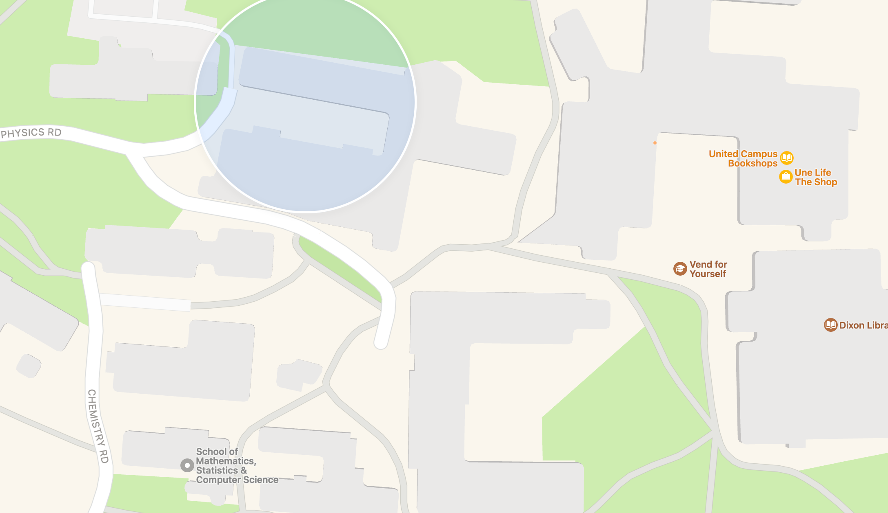
Map of Facility
Please refer to the map handout.
Be aware of parking, security.
??? Add any addition site specific information eg: enter form Holden street, Bus A89 stops at Finders Street etc…
Notes:
If you have a map of your facility please include in here if possible.

Slide 14

Key Contacts
There are numerous reasons why you may need to make contact with staff during your placement here are a few key contacts for you to make a note of
Facilitator details – insert your phone number and email (optional)
Hospital Switch – Insert details
Accommodation/ admin contact – Insert details
Clinical Nurse Educator for students – Insert details
Infection Control – Insert details
Please also ensure that you obtain contact details for your ward
Name and contact number for preceptor/ward buddy
Nursing Unit Manager
Notes:
This is a great time to speak to the students regarding when they might make contact-

Slide 15
Roster and hours in line with WHS
If you do not already have a roster it will be provided to you by the end of the day.
Please ensure that your roster matches the requirements set out in your Nursing Course Handbook.
Any alterations to rosters must be done in consultation with the ward and the clinical facilitator.
Reminder - Students must not work more that 48hrs in a week
Notes:
Please advise student---If you have a specific request that was not previously advised please speak to me after orientation

Slide 16
General Safety Rules
It is very important that you are mindful of your own and others safety at all times during placement. Please be mindful of the following;
Maintain patient and organisation confidentiality at all times
Wear PPE as required
Wear ID badge in a visible position
Smoking is not permitted on site
Do not wedge open fire doors
Practice safe manual handling
Be aware of your own personal security – report security concerns immediately
Report all accidents, incidents, near misses & unsafe conditions to your supervisor
*Please refer to your handout/student ID Card/ which outlines the procedures and phone numbers to use in emergency situations.
Notes:
*Amend as appropriate to your facility
Please go through evacuation duress alarms fire safety that is specific to your facility NOW Please expand on the key points above as required

Slide 17
Dress Code in line with WHS
In line with infection control principles - UNE nursing uniform must be clean each day.
Please ensure you also adhere to the following requirements:
Bare below the elbows – no hand (excepting one plain wedding ring only), wrist or forearm jewellery.
Fingernails – clean, short and not sharp, no artificial nails, nail art or nail polish.
Hair longer than shoulder length must be tied back and tidy (not long loose ponytail).
Do not wear objects/clothing hanging around neck that can be pulled, twisted or grabbed or promote spread of infection.
Clothing to be in good repair, freshly laundered and not wrinkled. Should not impede with hand and forearm cleansing. Appropriate shirt, slacks and skirt of corporate length.
Footwear– navy blue or black, non-porous upper and enclosed with flat, stable, non-slip sole.

Slide 18
Standard Precautions
Standard precautions always assume all blood and body fluids are potentially infectious.
Protecting ourselves and our patients.
Washing hands – use alcohol based hand rubs when hands are not physically soiled
Checking skin integrity
Wear gloves, eye protection, face masks
When protection is required wear disposable white or impervious yellow gowns
Dispose of sharps correctly
Place soiled linen in clear plastic bags
Dispose of clinical waste into yellow clinical waste bag
Notes:
These are points that you may wish to expand on

Slide 19
Student Responsibilities
Be accountable for placement documentation and procedure achievements
Communicate openly with your Clinical Partner/Facilitator at all times
Advise their facilitator and the University of any problems or concerns that may affect your clinical performance
Attend placement with learning objectives (goals)
Be an active and participatory learner who incorporates constructive criticisms into your future practice
Decline to participate in procedures or situations which are beyond your level of experience or abilities
Ensure that you are familiar with and adhere to your appropriate scope of practice as outlined in your Clinical Record Book.
Notes:
As a student you also have responsibilities that will assist to ensure you have the best placement experience possible please be aware of the following key points
Expand and add as required.

Slide 20
Behavior guidelines
  Please remember the following general guidelines that will assist you to obtain the most from this experience.
  Respect your colleagues and supervisors, patients and their families. Maintain professional appearance, behaviour & attitude at all times
  Introduce yourself as a student to all staff, family and patients/client when interacting with them
  Always seek permission from the patient/cline and the responsible healthcare practitioner before proceeding with an intervention
  Accept responsibility for all relevant aspects of patient care within the limitations of your practice
  Engage in open disclosure communication in the case of an adverse event
Notes:
Mention code of conduct ?

Slide 21
Feedback
Occasionally your facilitator may have to give you feedback that is not easy to hear
It is best that you and your facilitator have a conversation around approach sensitive situations prior to them occurring.
Please remember your facilitator expects that you will accept constructive criticism in a professional manner
your facilitator will address issues with you as soon as they become aware of them
You need to let your facilitator know how you would like to approach a crucial conversation.
Spend some time now talking as a group about individual expectations around feedback.

Slide 22

Debrief
During your placement group debriefing will be offered (insert your planned session frequency) and PRN
Should you wish to debrief please contact:
  Your clinical facilitator
  The Clinical Coordinator
  UNE counseling services
Notes:
Debriefing does not have to occur daily. Suggested weekly.

Slide 23

Things to do while in placement town
If you have key tips for the students on what to do please enter on this slide ☺
EG: local markets, tourist attractions
Notes:
Optional Slide

Slide 24

Questions????

